Slide 1
FROG PUPPET ACTIVITY
Paper clips were used in this demonstration to hold the craft in place.
Source: https://www.pinterest.com/pin/669980882055667569/

Slide 2
The square used is 6x6. inches.
Begin with a square sheet of construction paper. Fold the square in half vertically and horizontally.

Slide 3
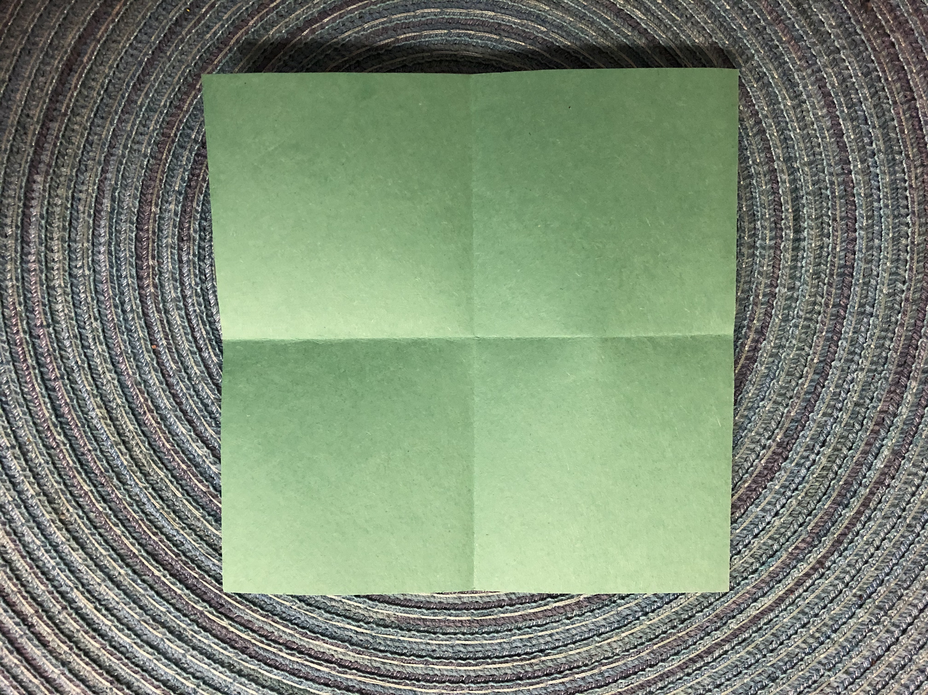
Your sheet should now display 4 even squares.

Slide 4
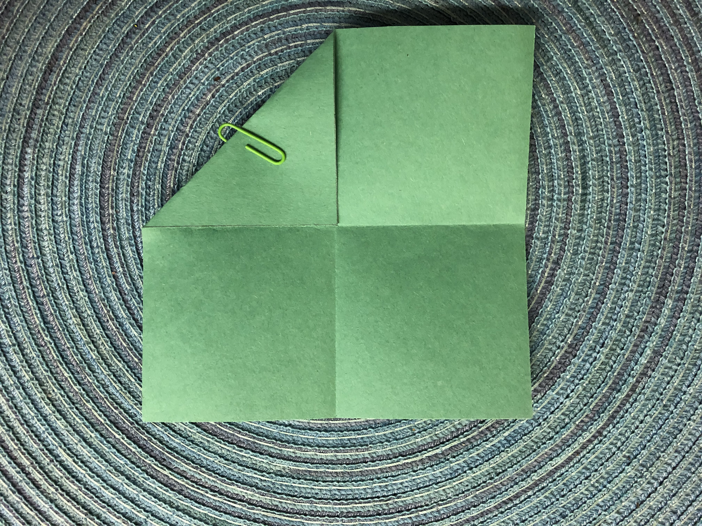
Fold each outside corner in towards the middle.

Slide 5
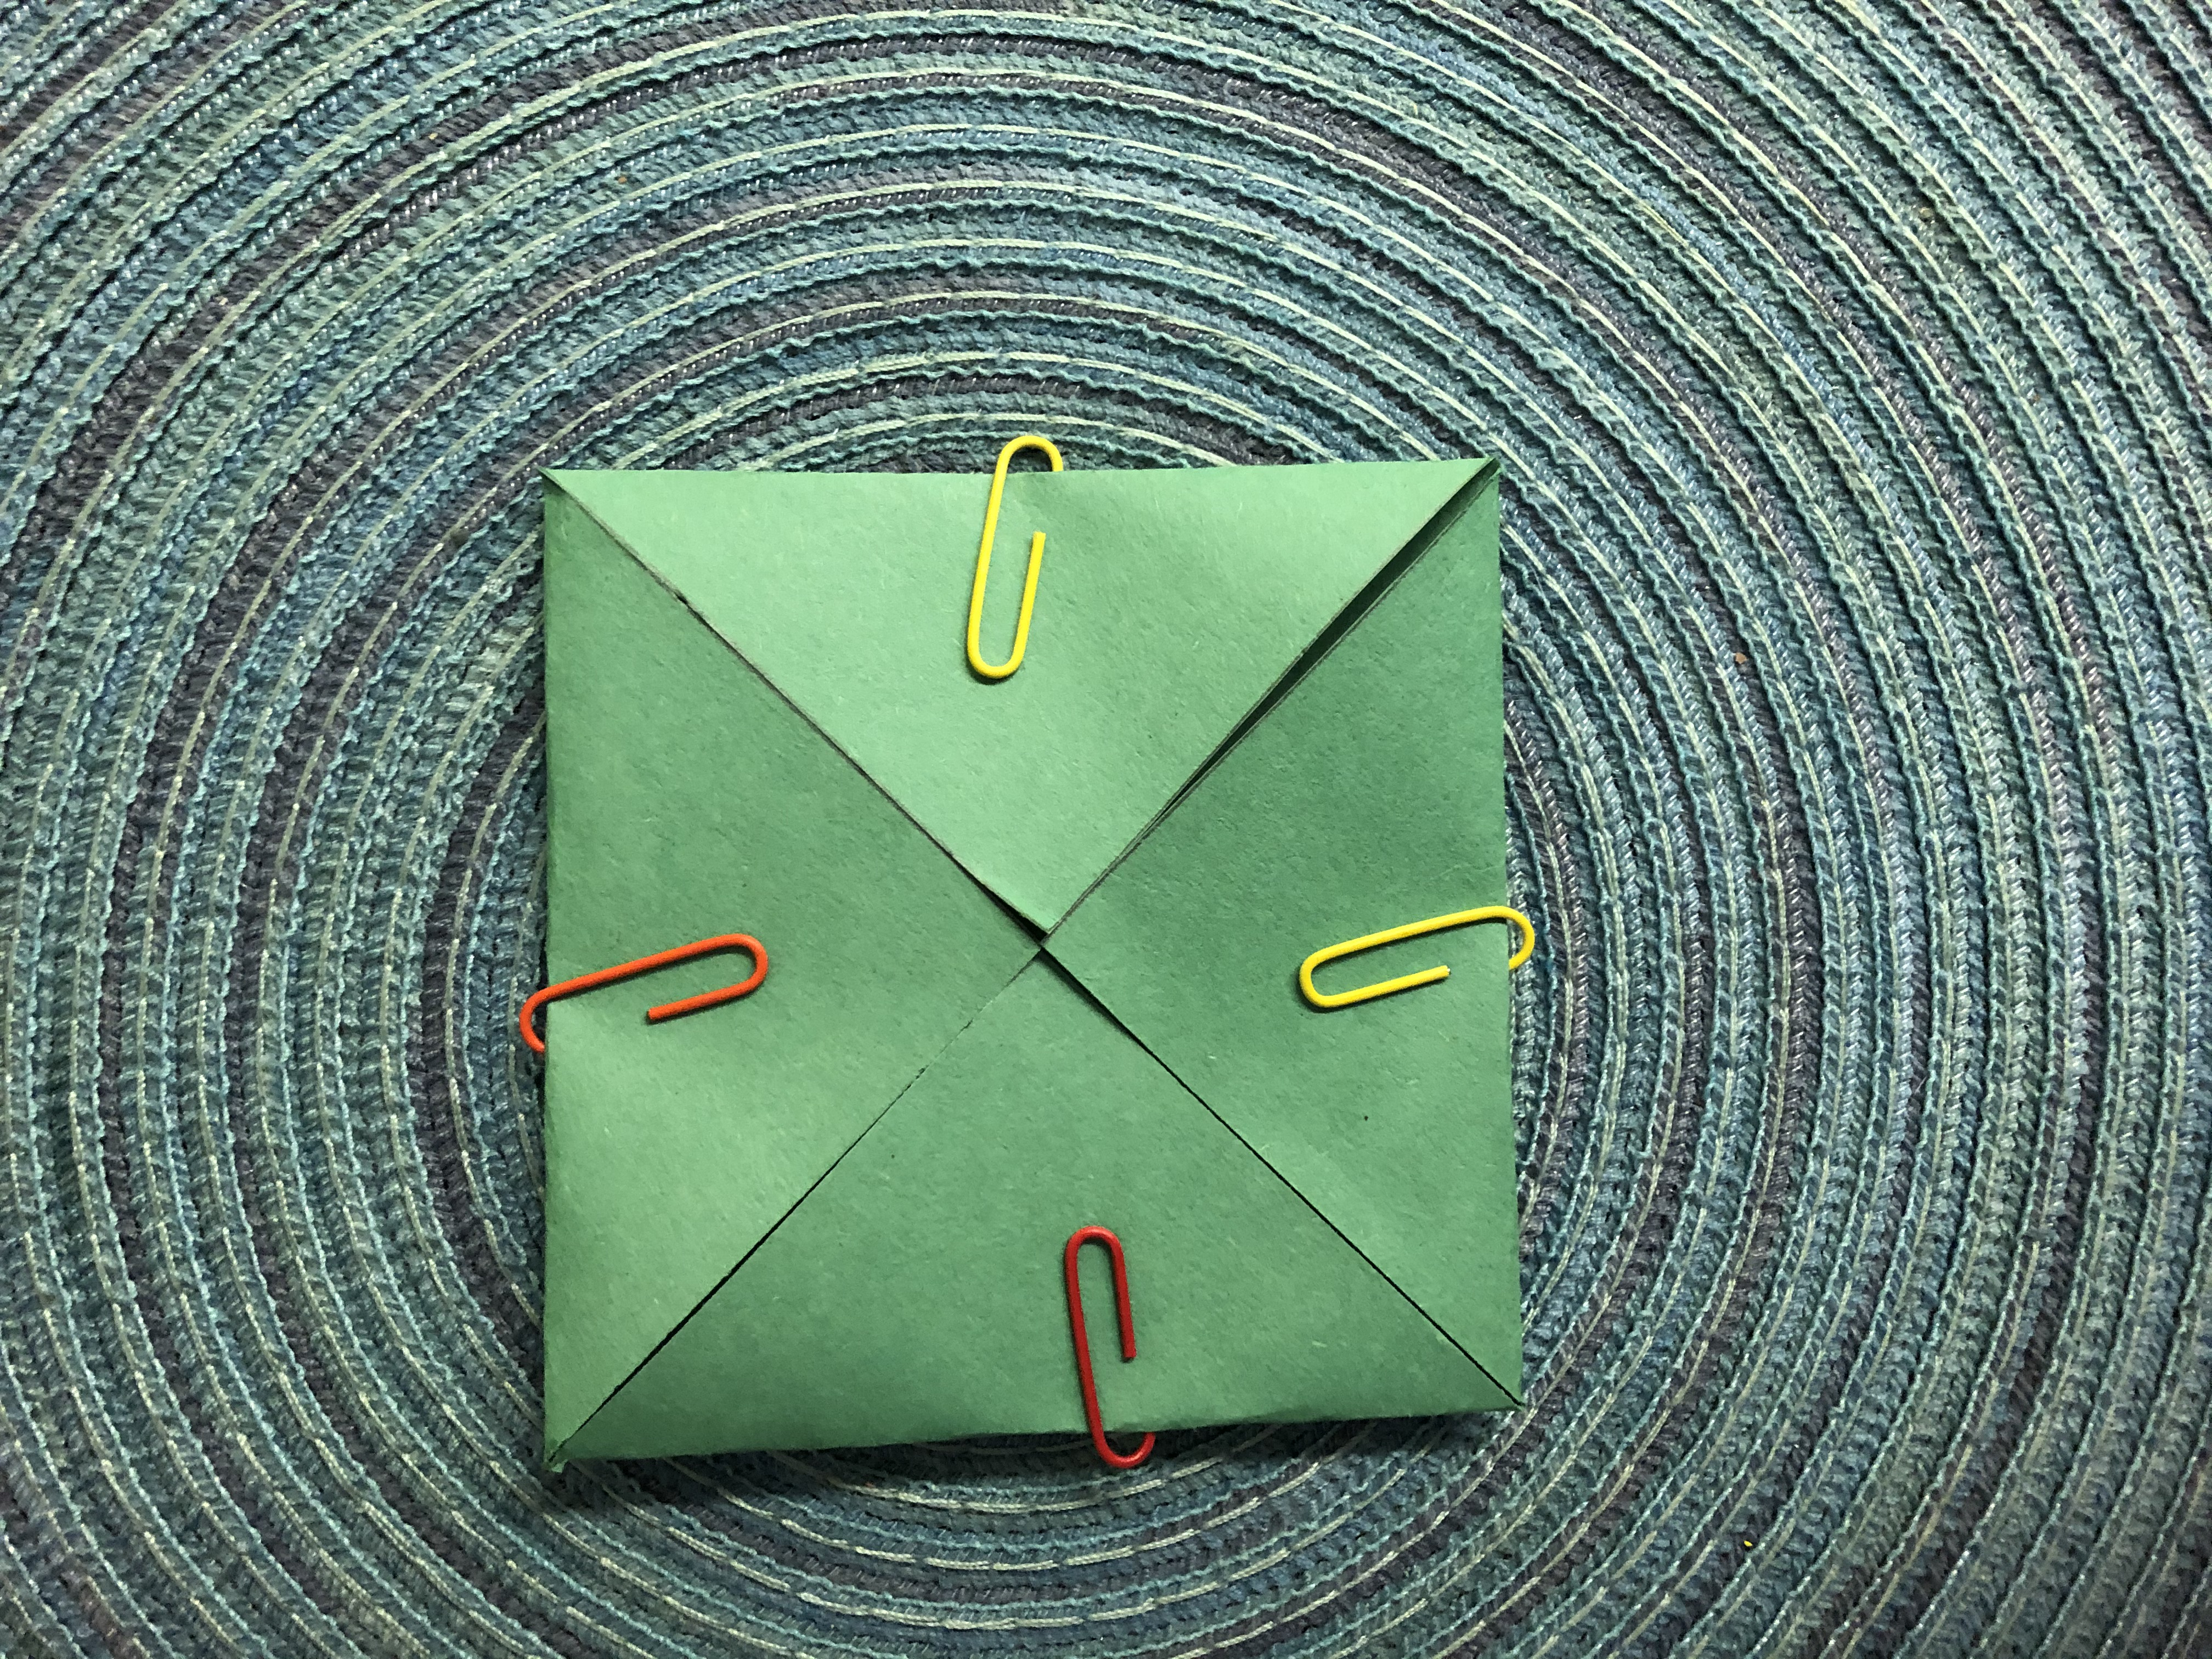
After folding in each corner, your puppet should like the image above.

Slide 6
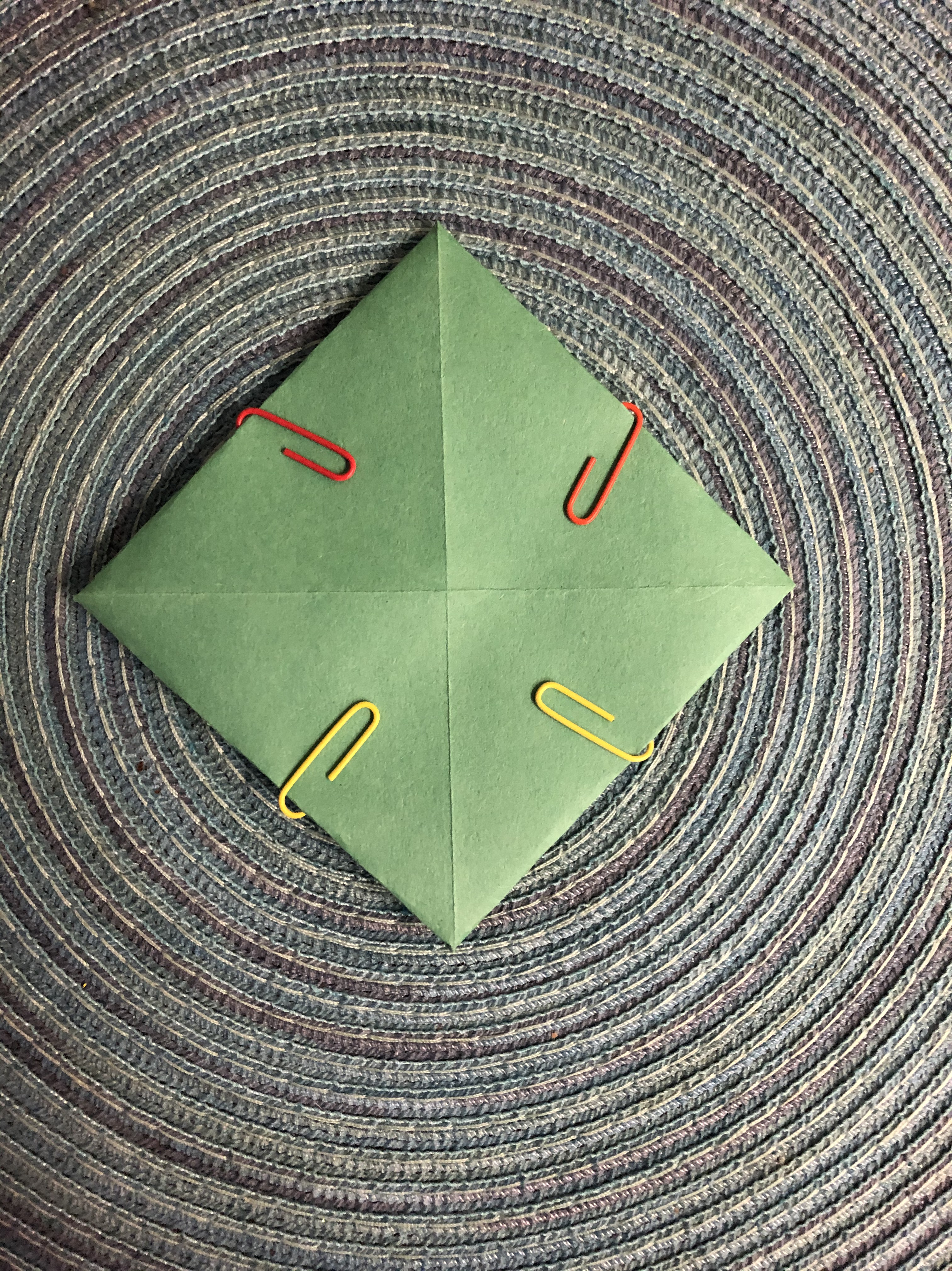
Flip over your shape and orient it to the shape of a diamond.

Slide 7
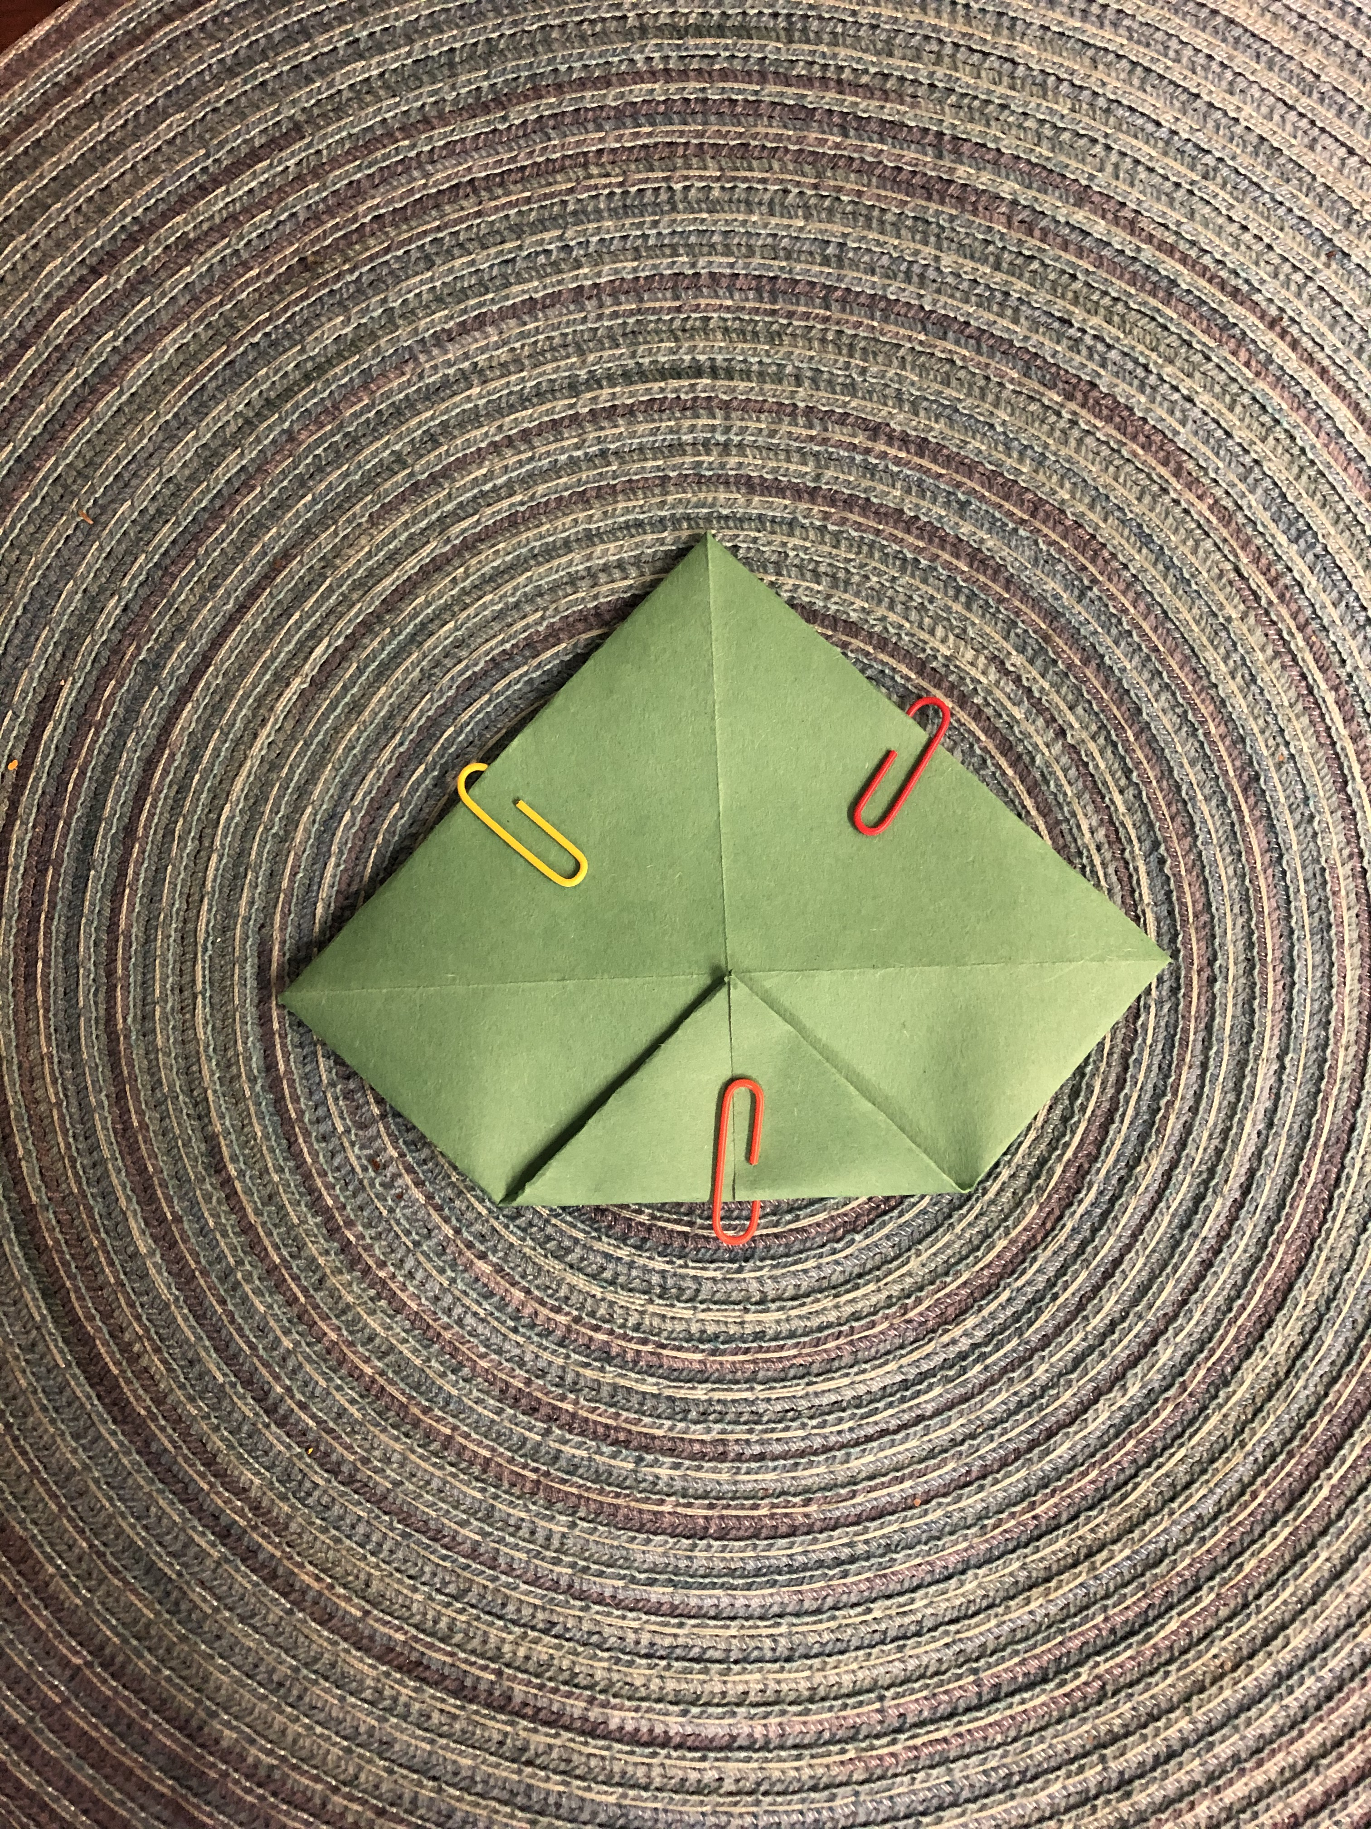
Fold the bottom corner of the diamond towards the middle.

Slide 8
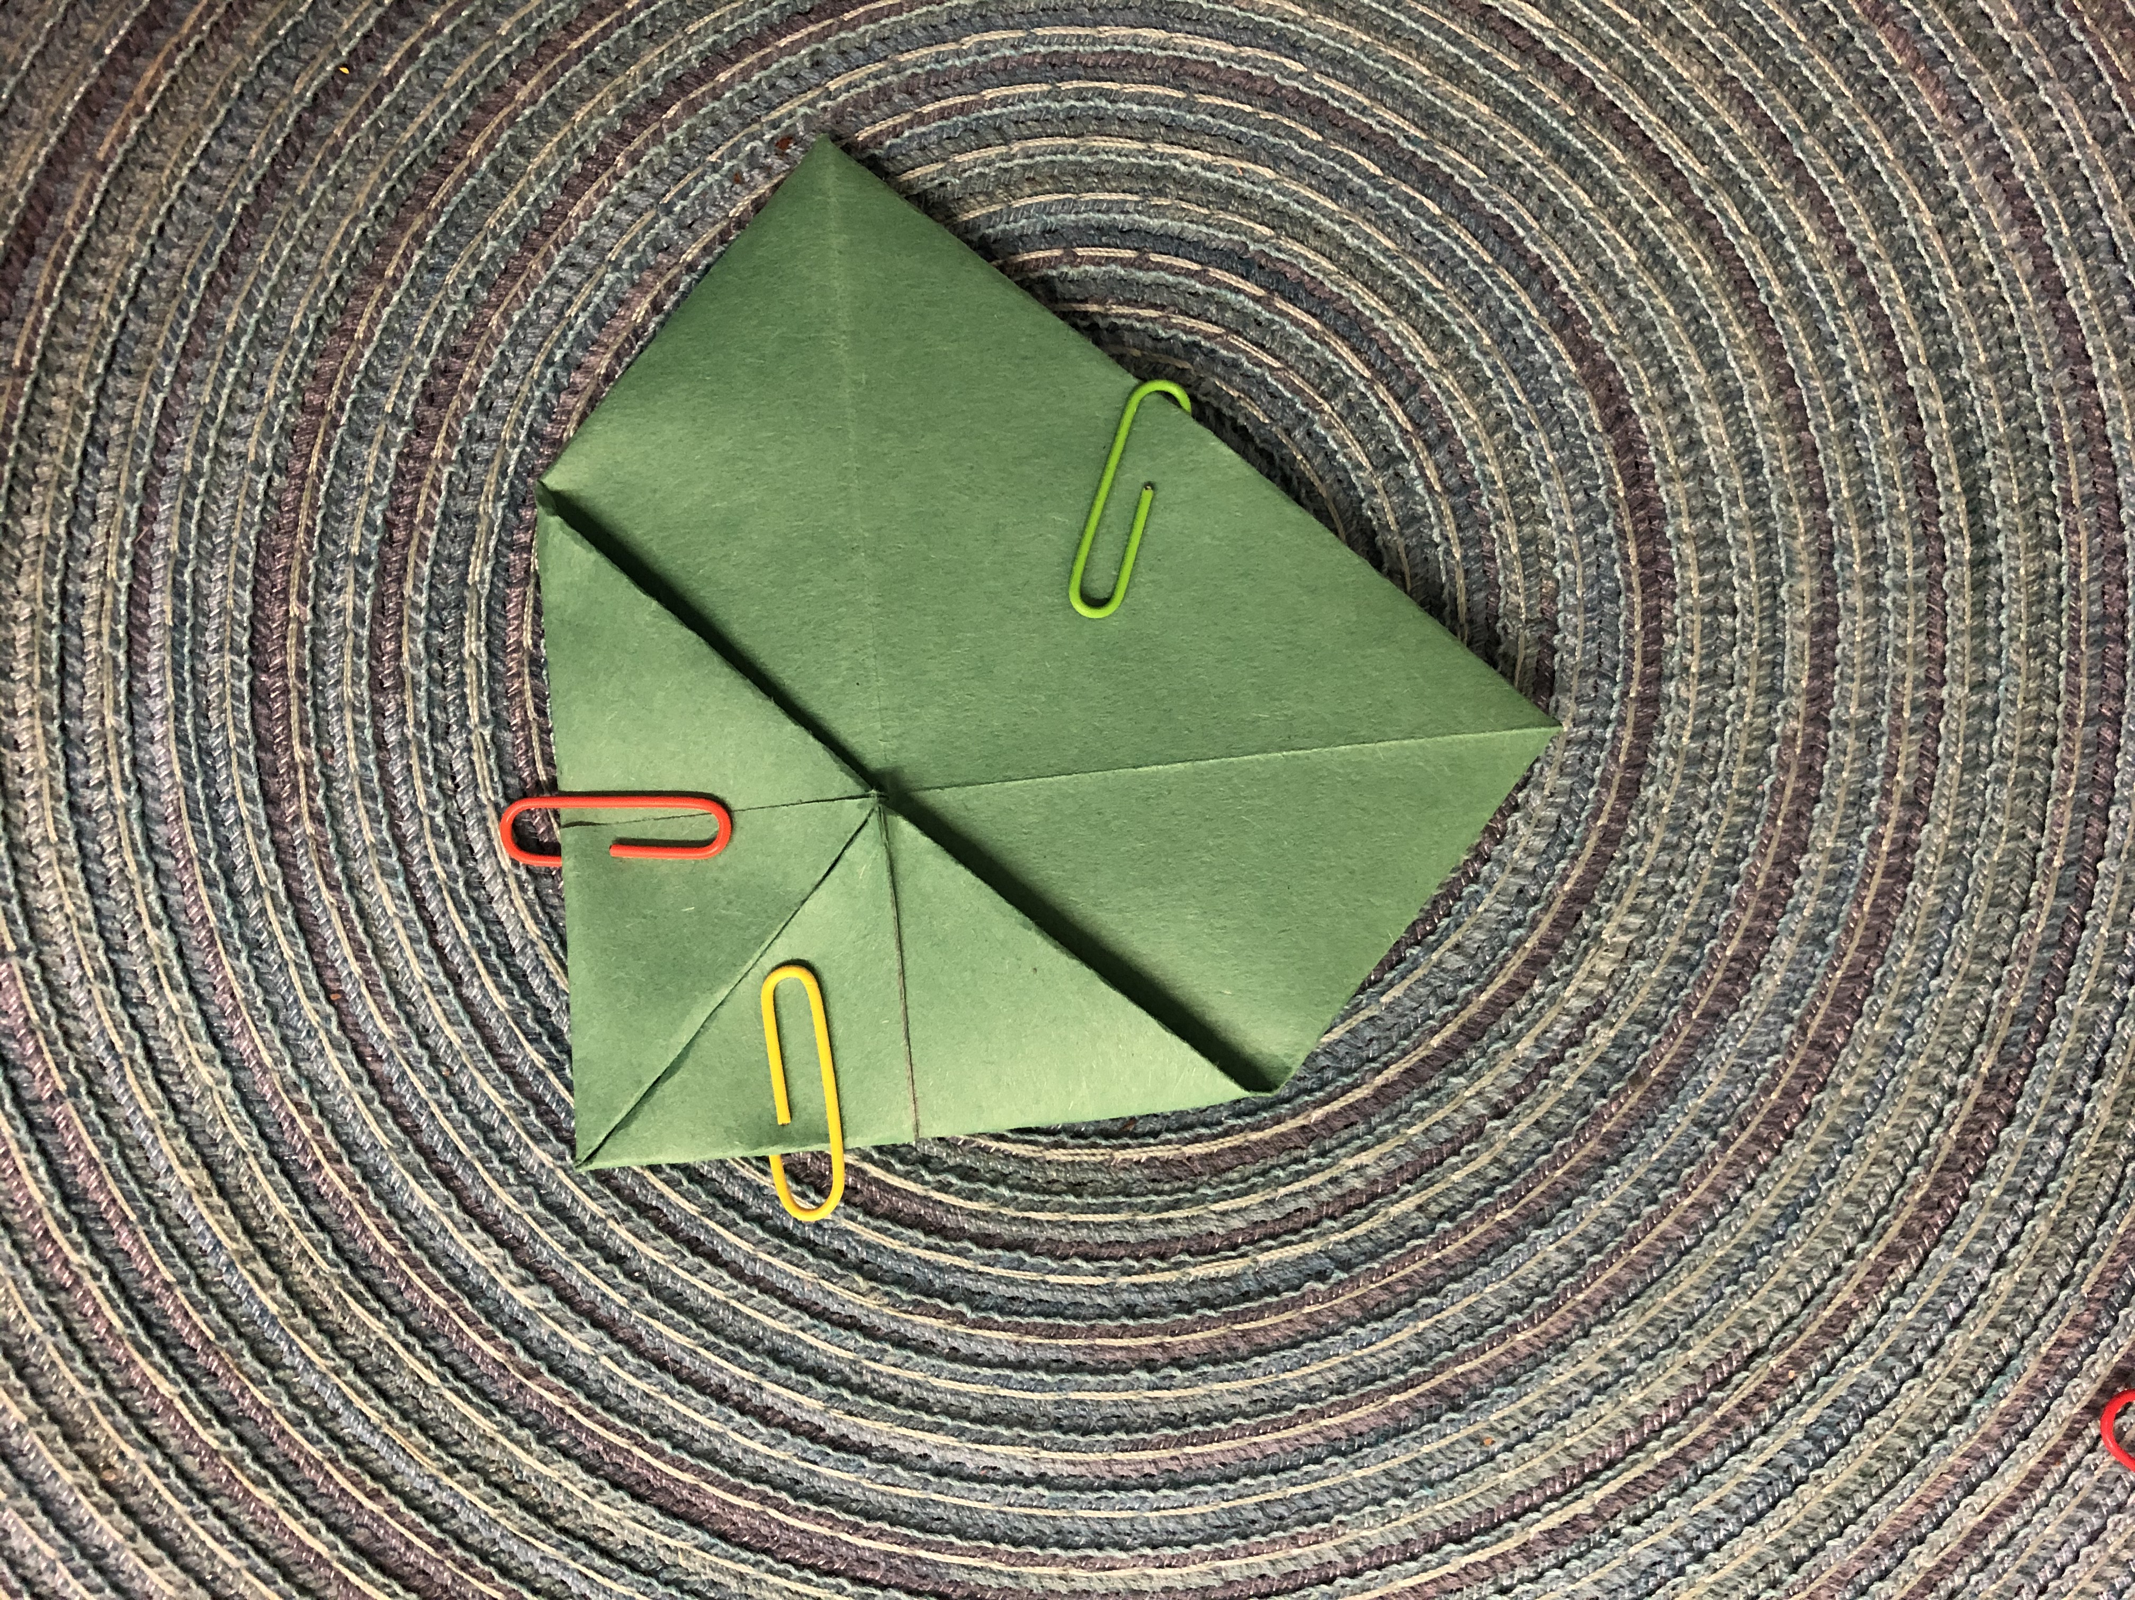
Fold the right corner of the diamond towards the middle.

Slide 9
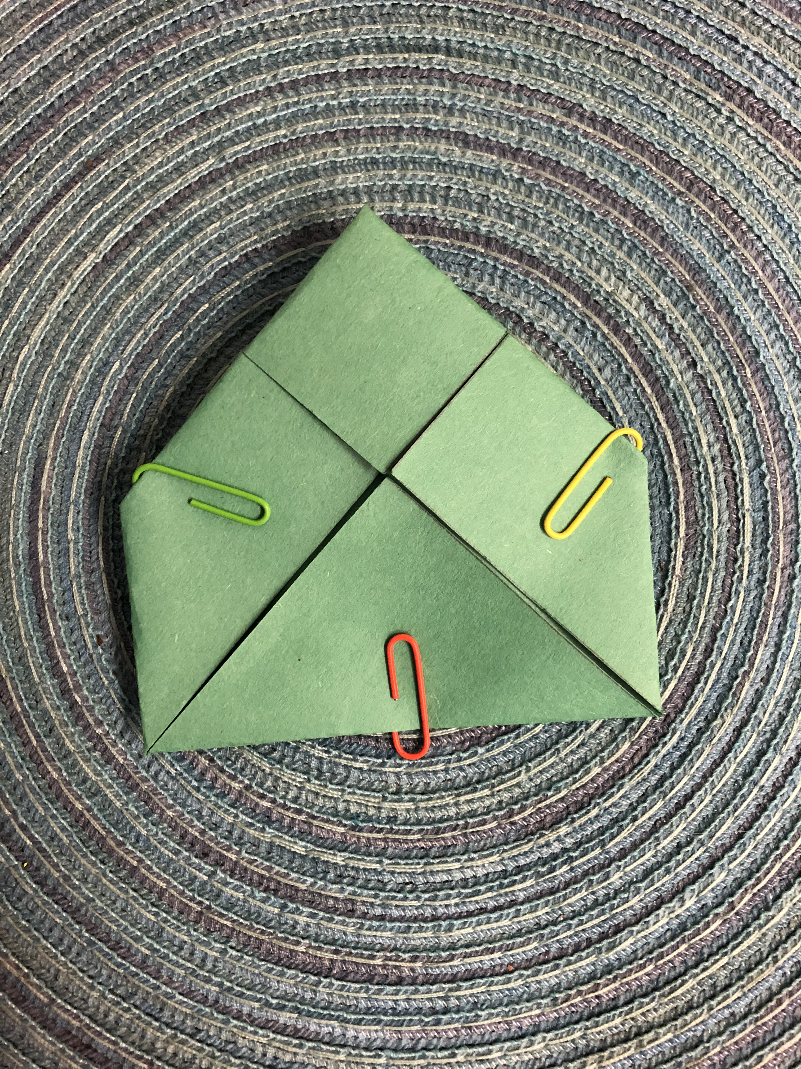
Flip over the puppet and orient it to look like the photo above.

Slide 10
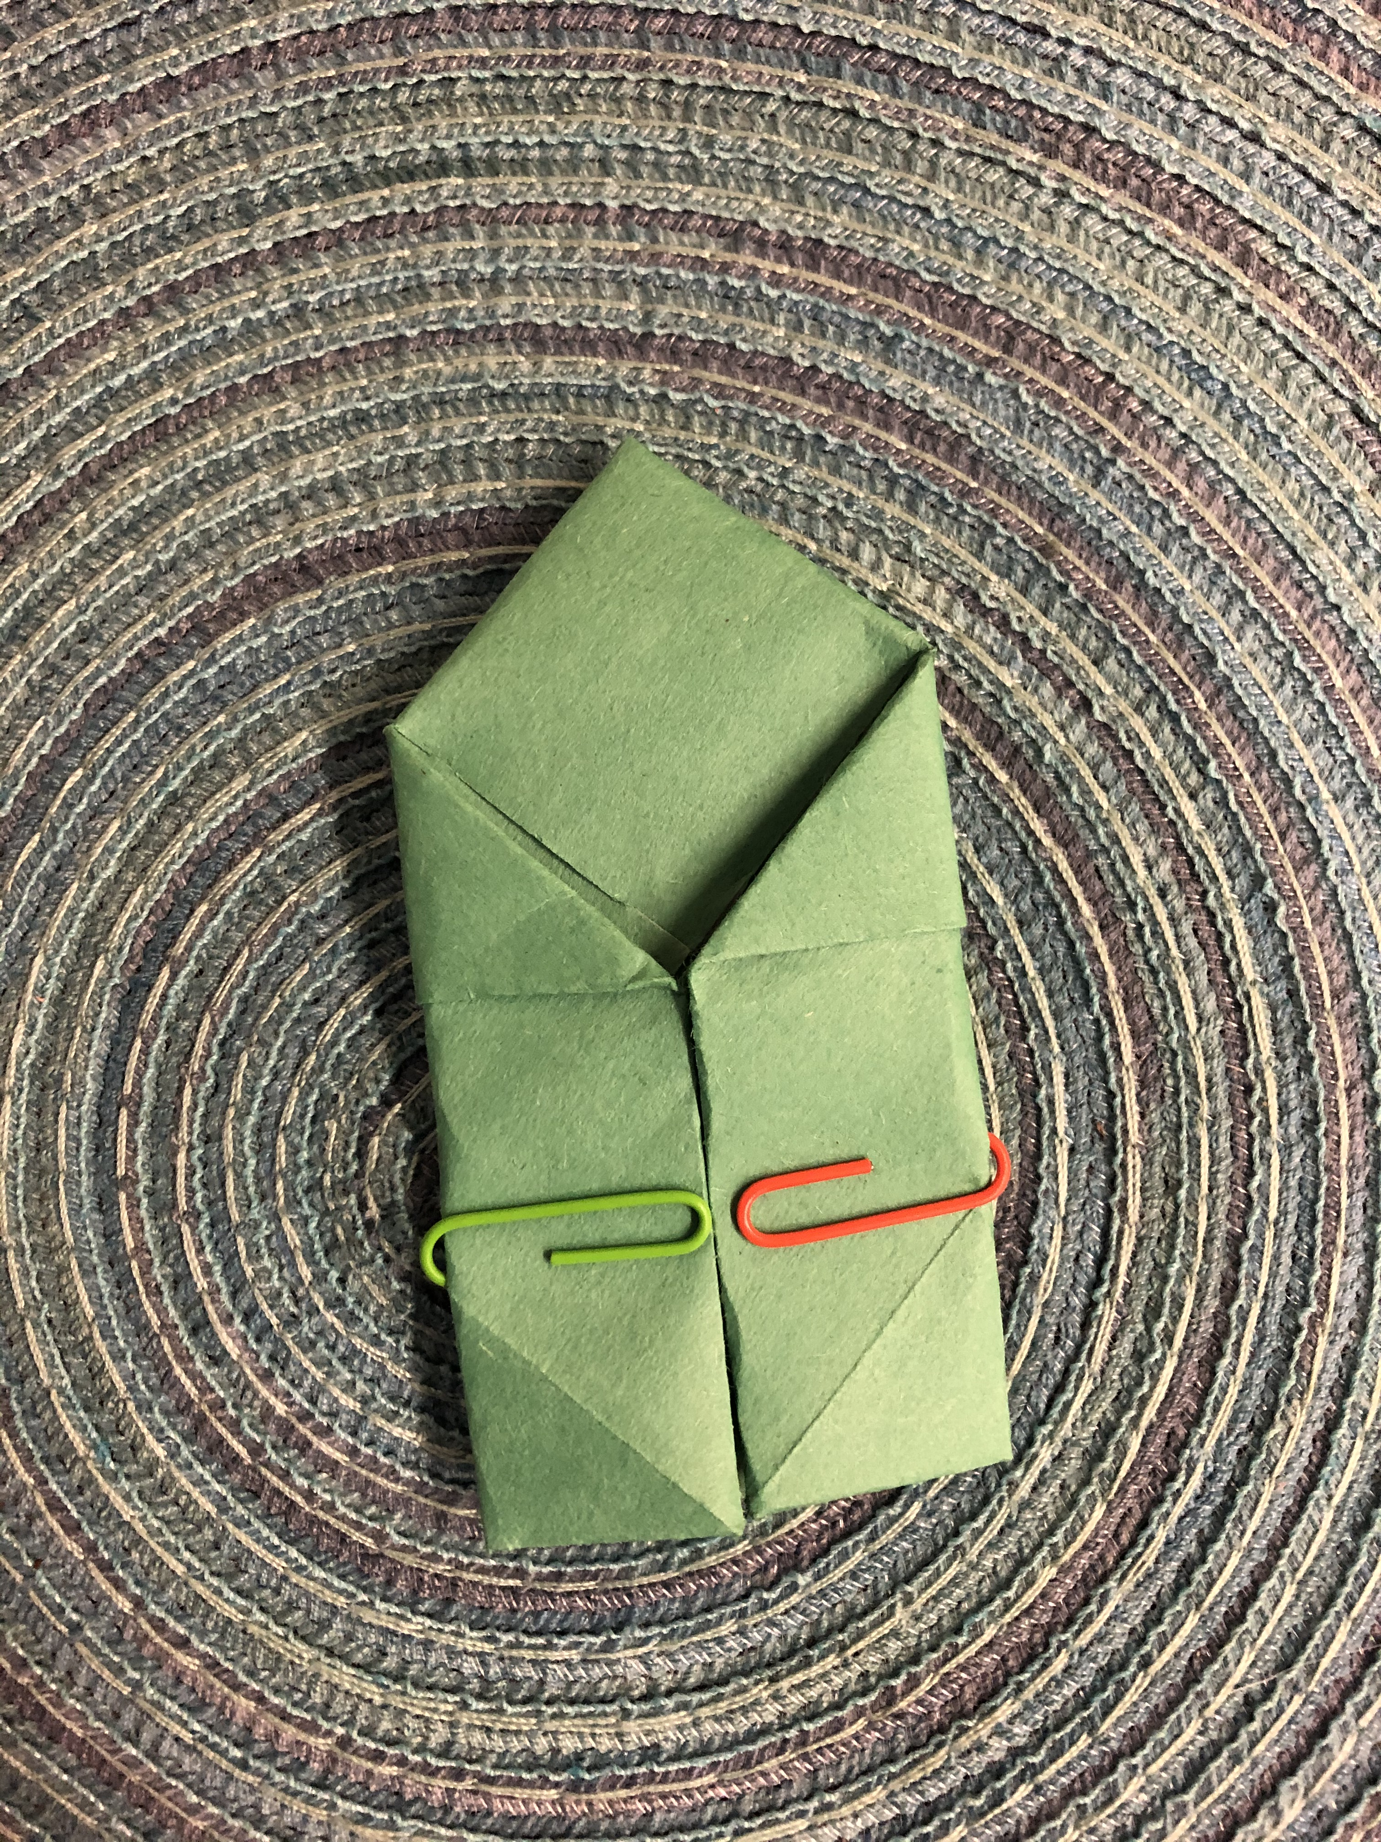
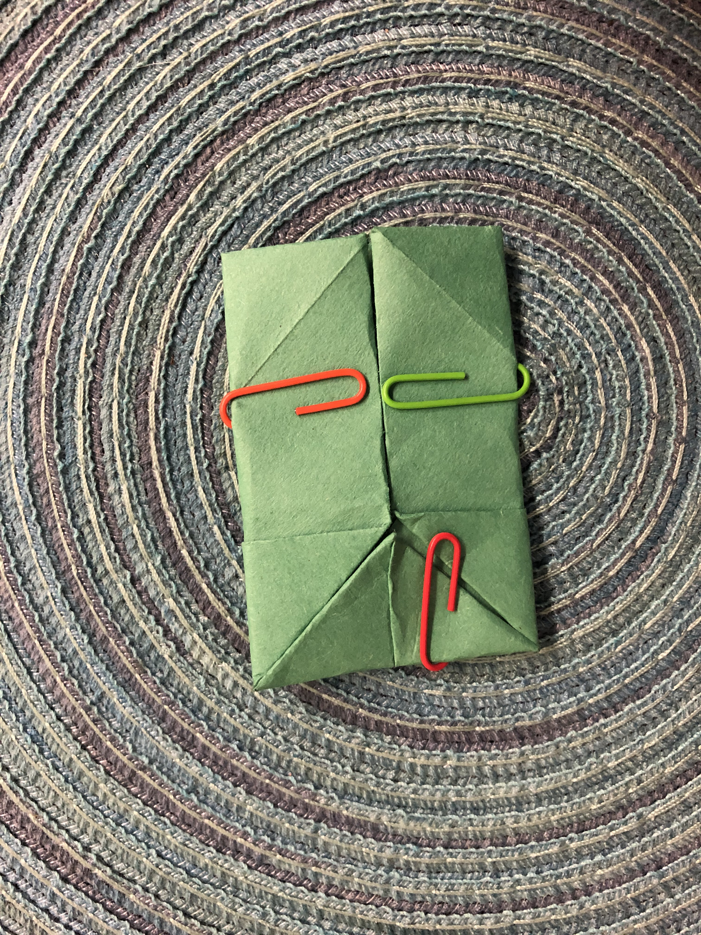
Fold both sides and the top of the puppet inwards towards the middle.

Slide 11
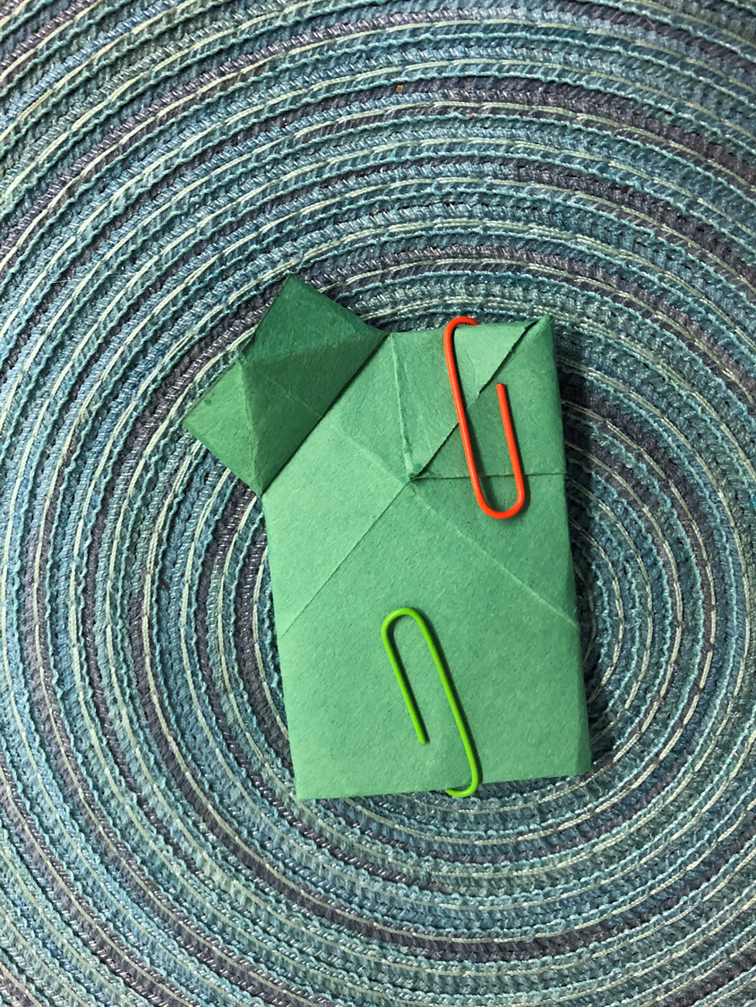
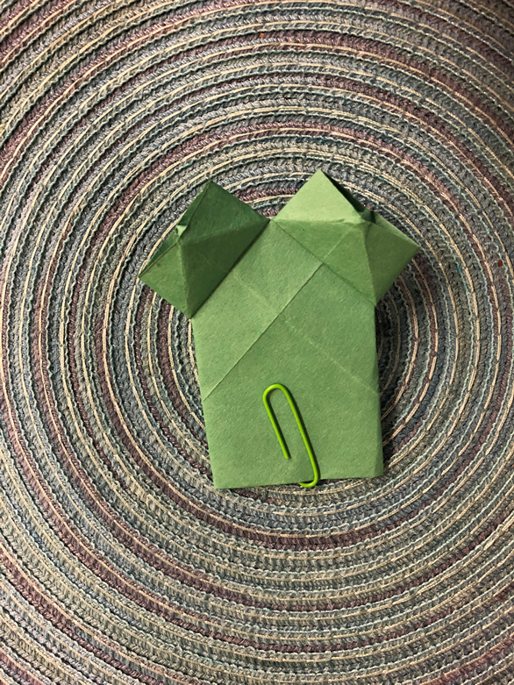
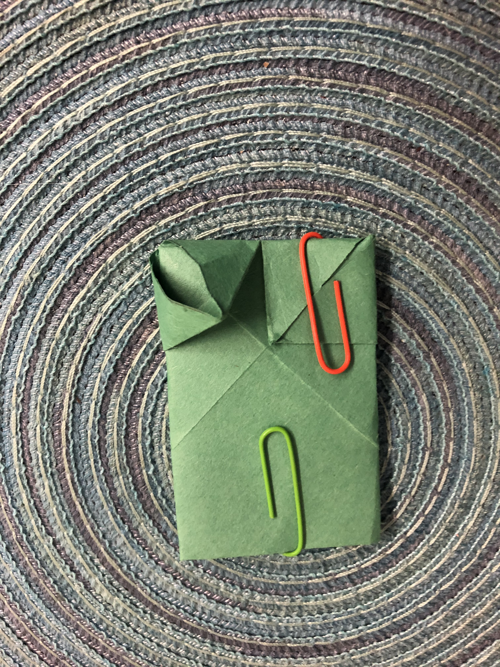
Turn over your puppet.
Push the bottom right corner of the top squares upwards to create the shape shown above.
This will create the eyes for your frog.
After folding up both sides, your puppet should look like so.
.

Slide 12
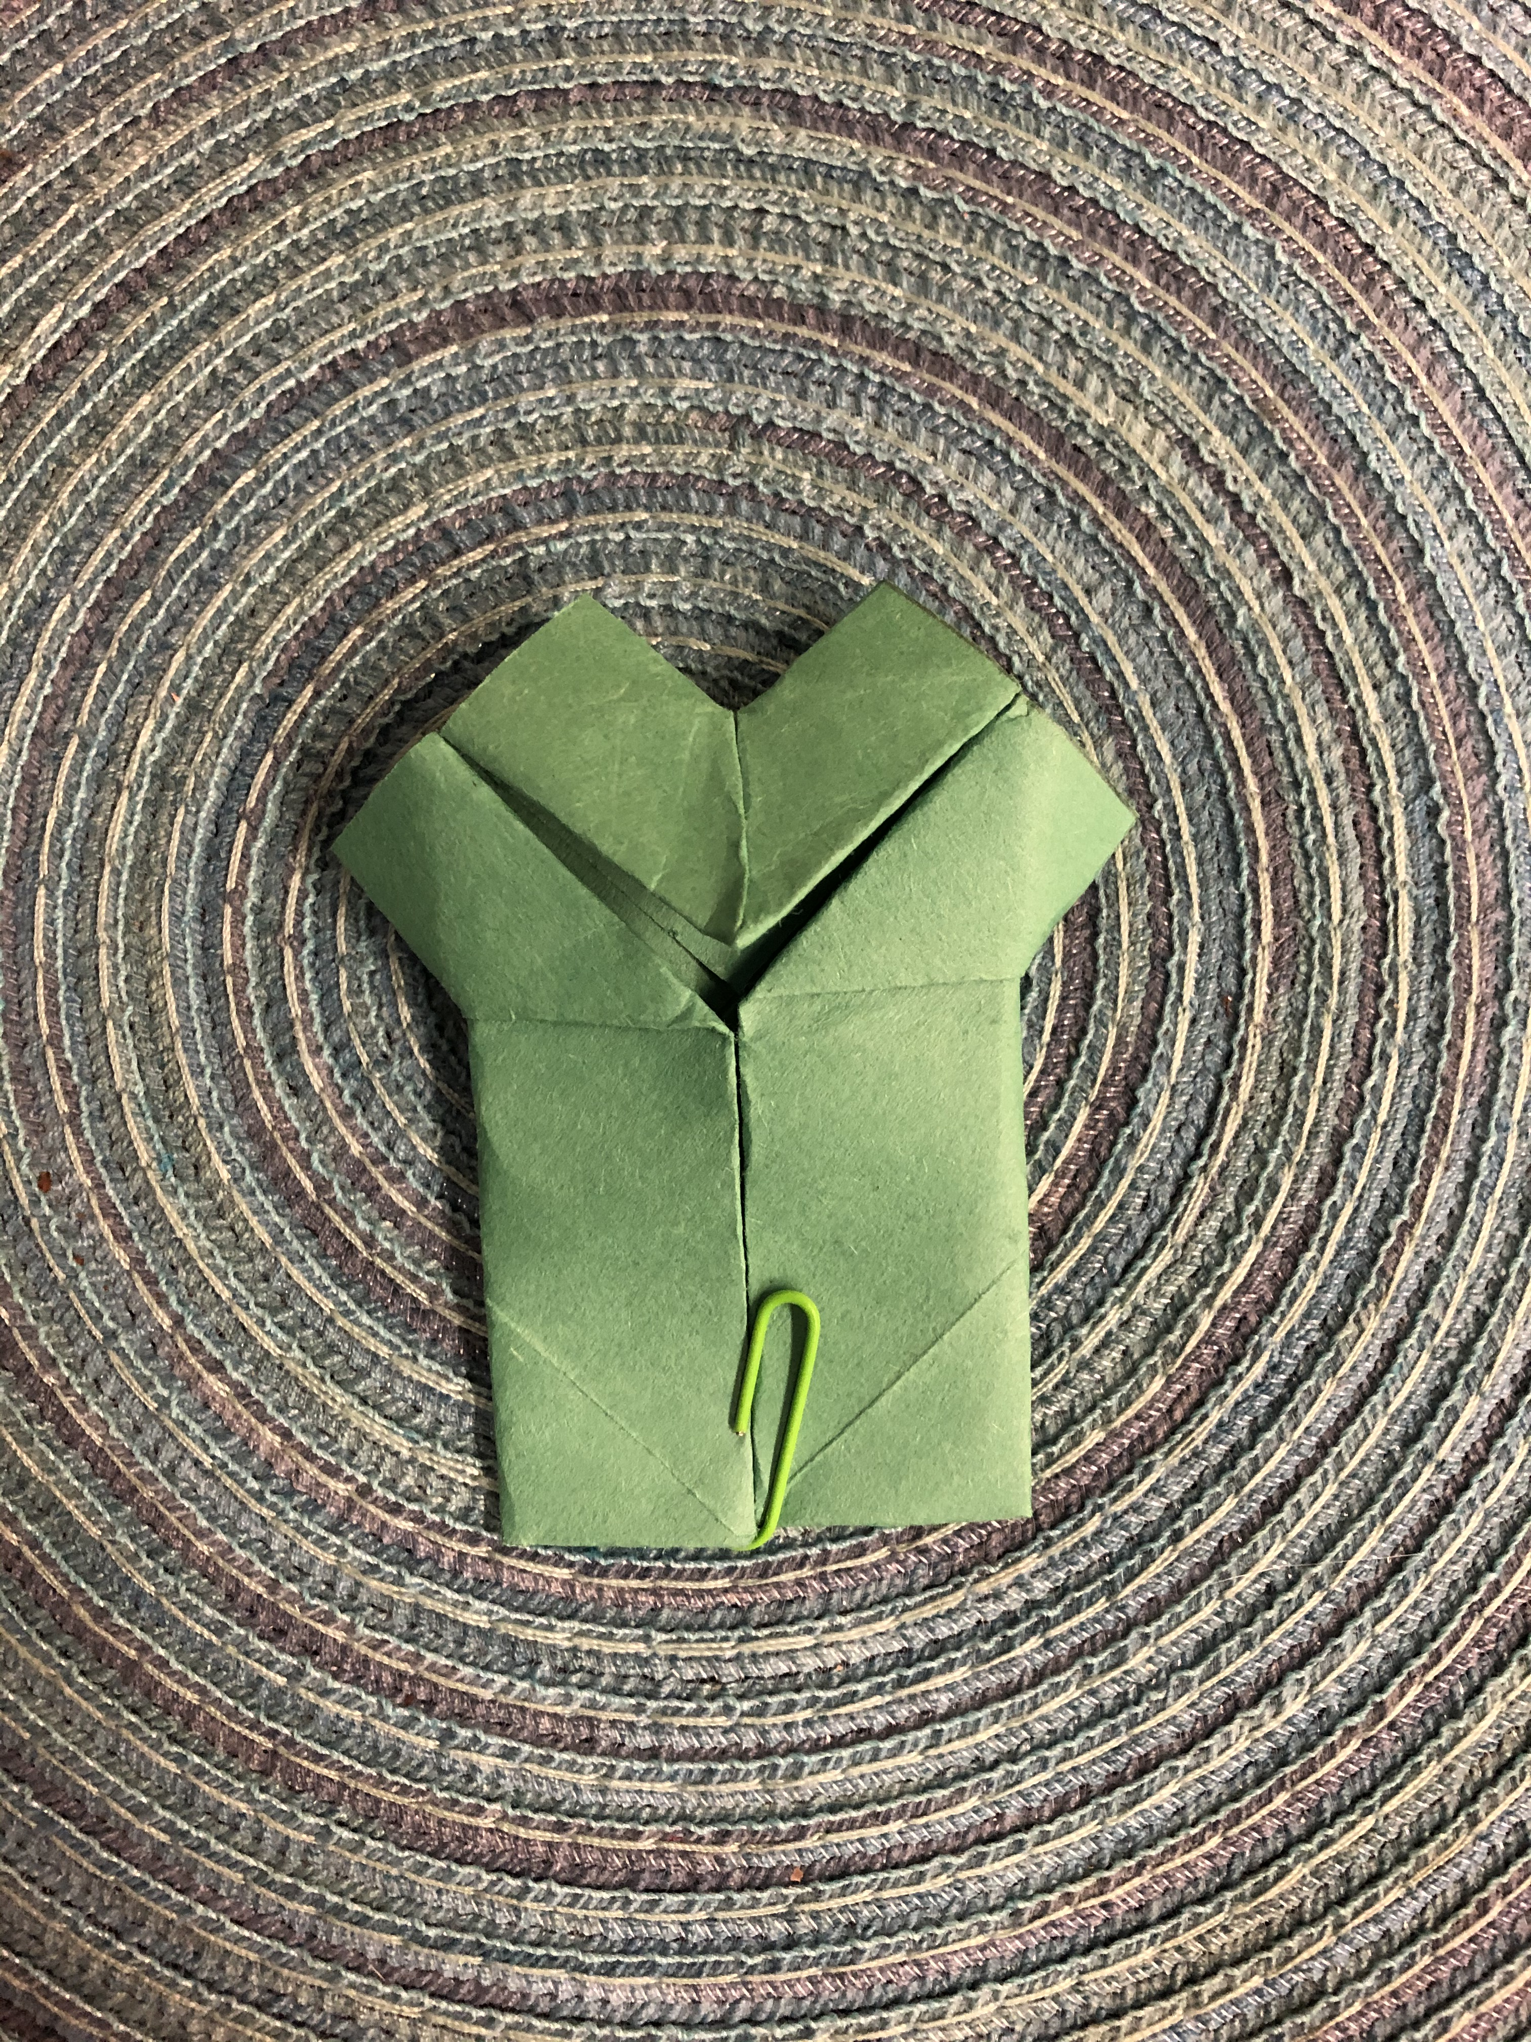
Flip over the puppet.

Slide 13
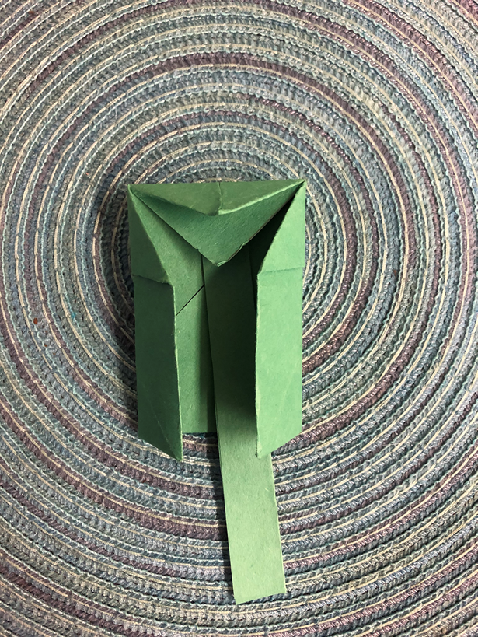
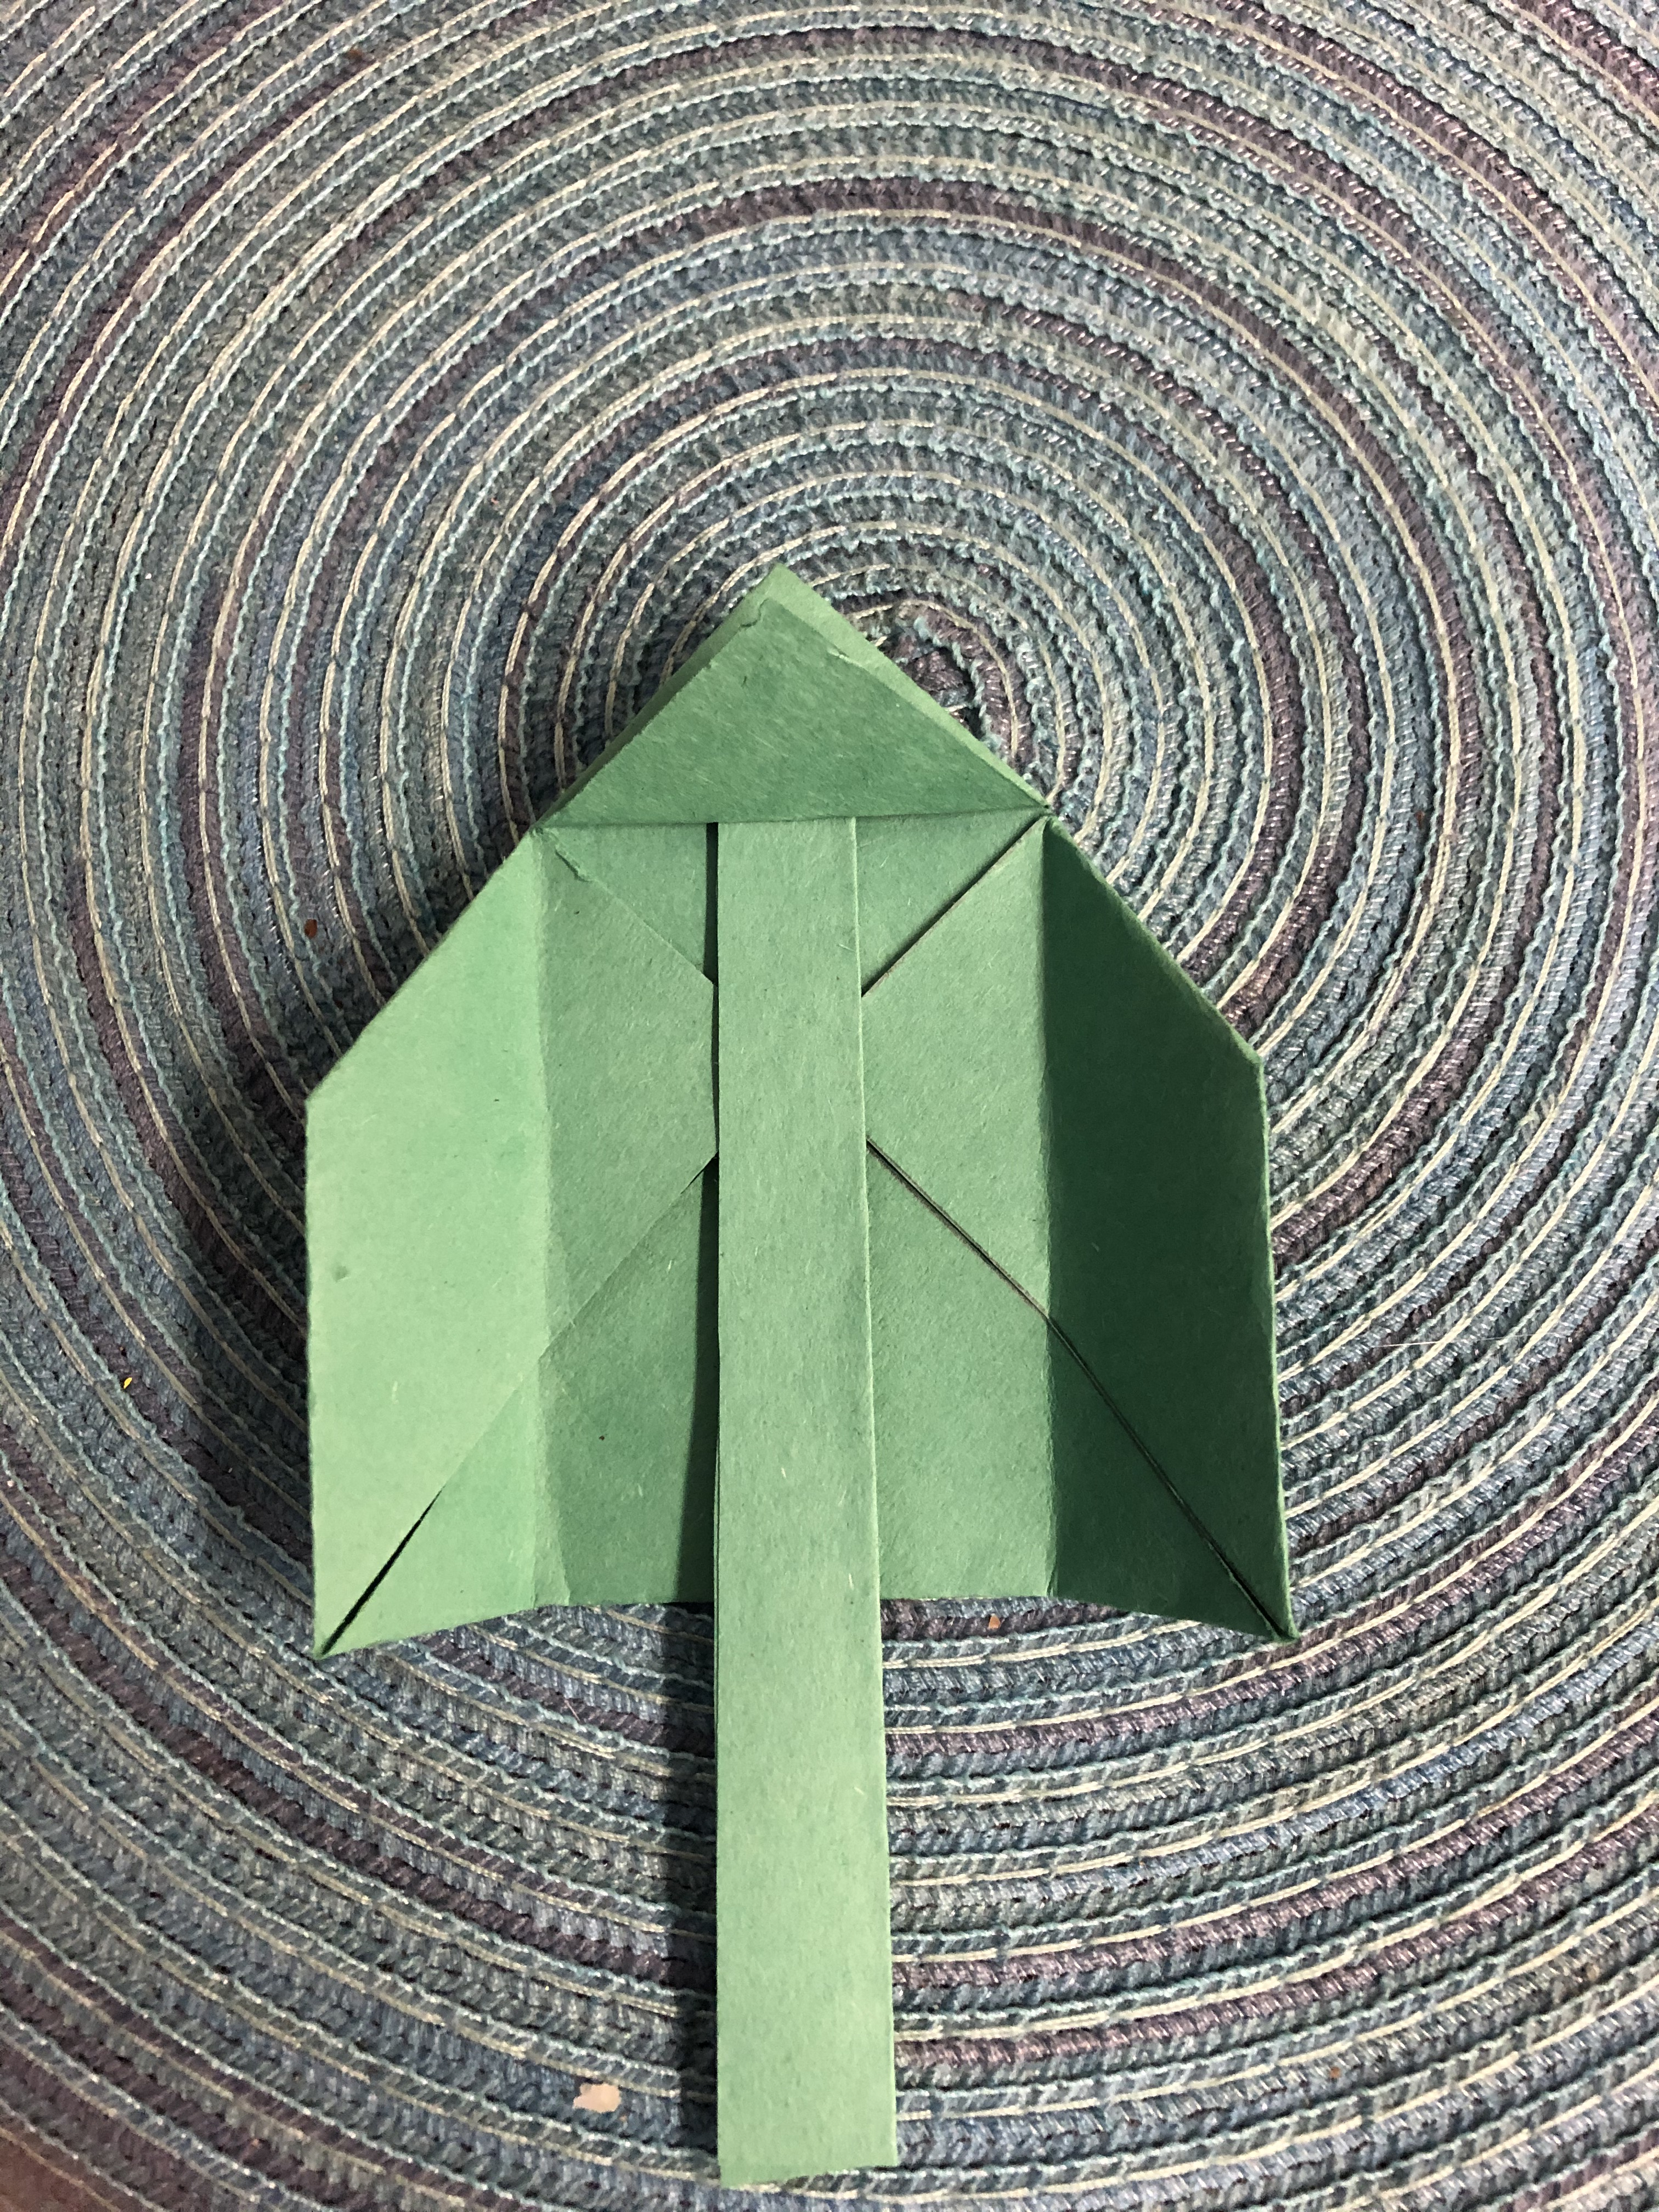
Take a strip of paper (approx. 4-5 inches) and fold it in half. Insert the folded strip under the bottom fold of your puppet. Your puppet should now look like the image on the right.

Slide 14
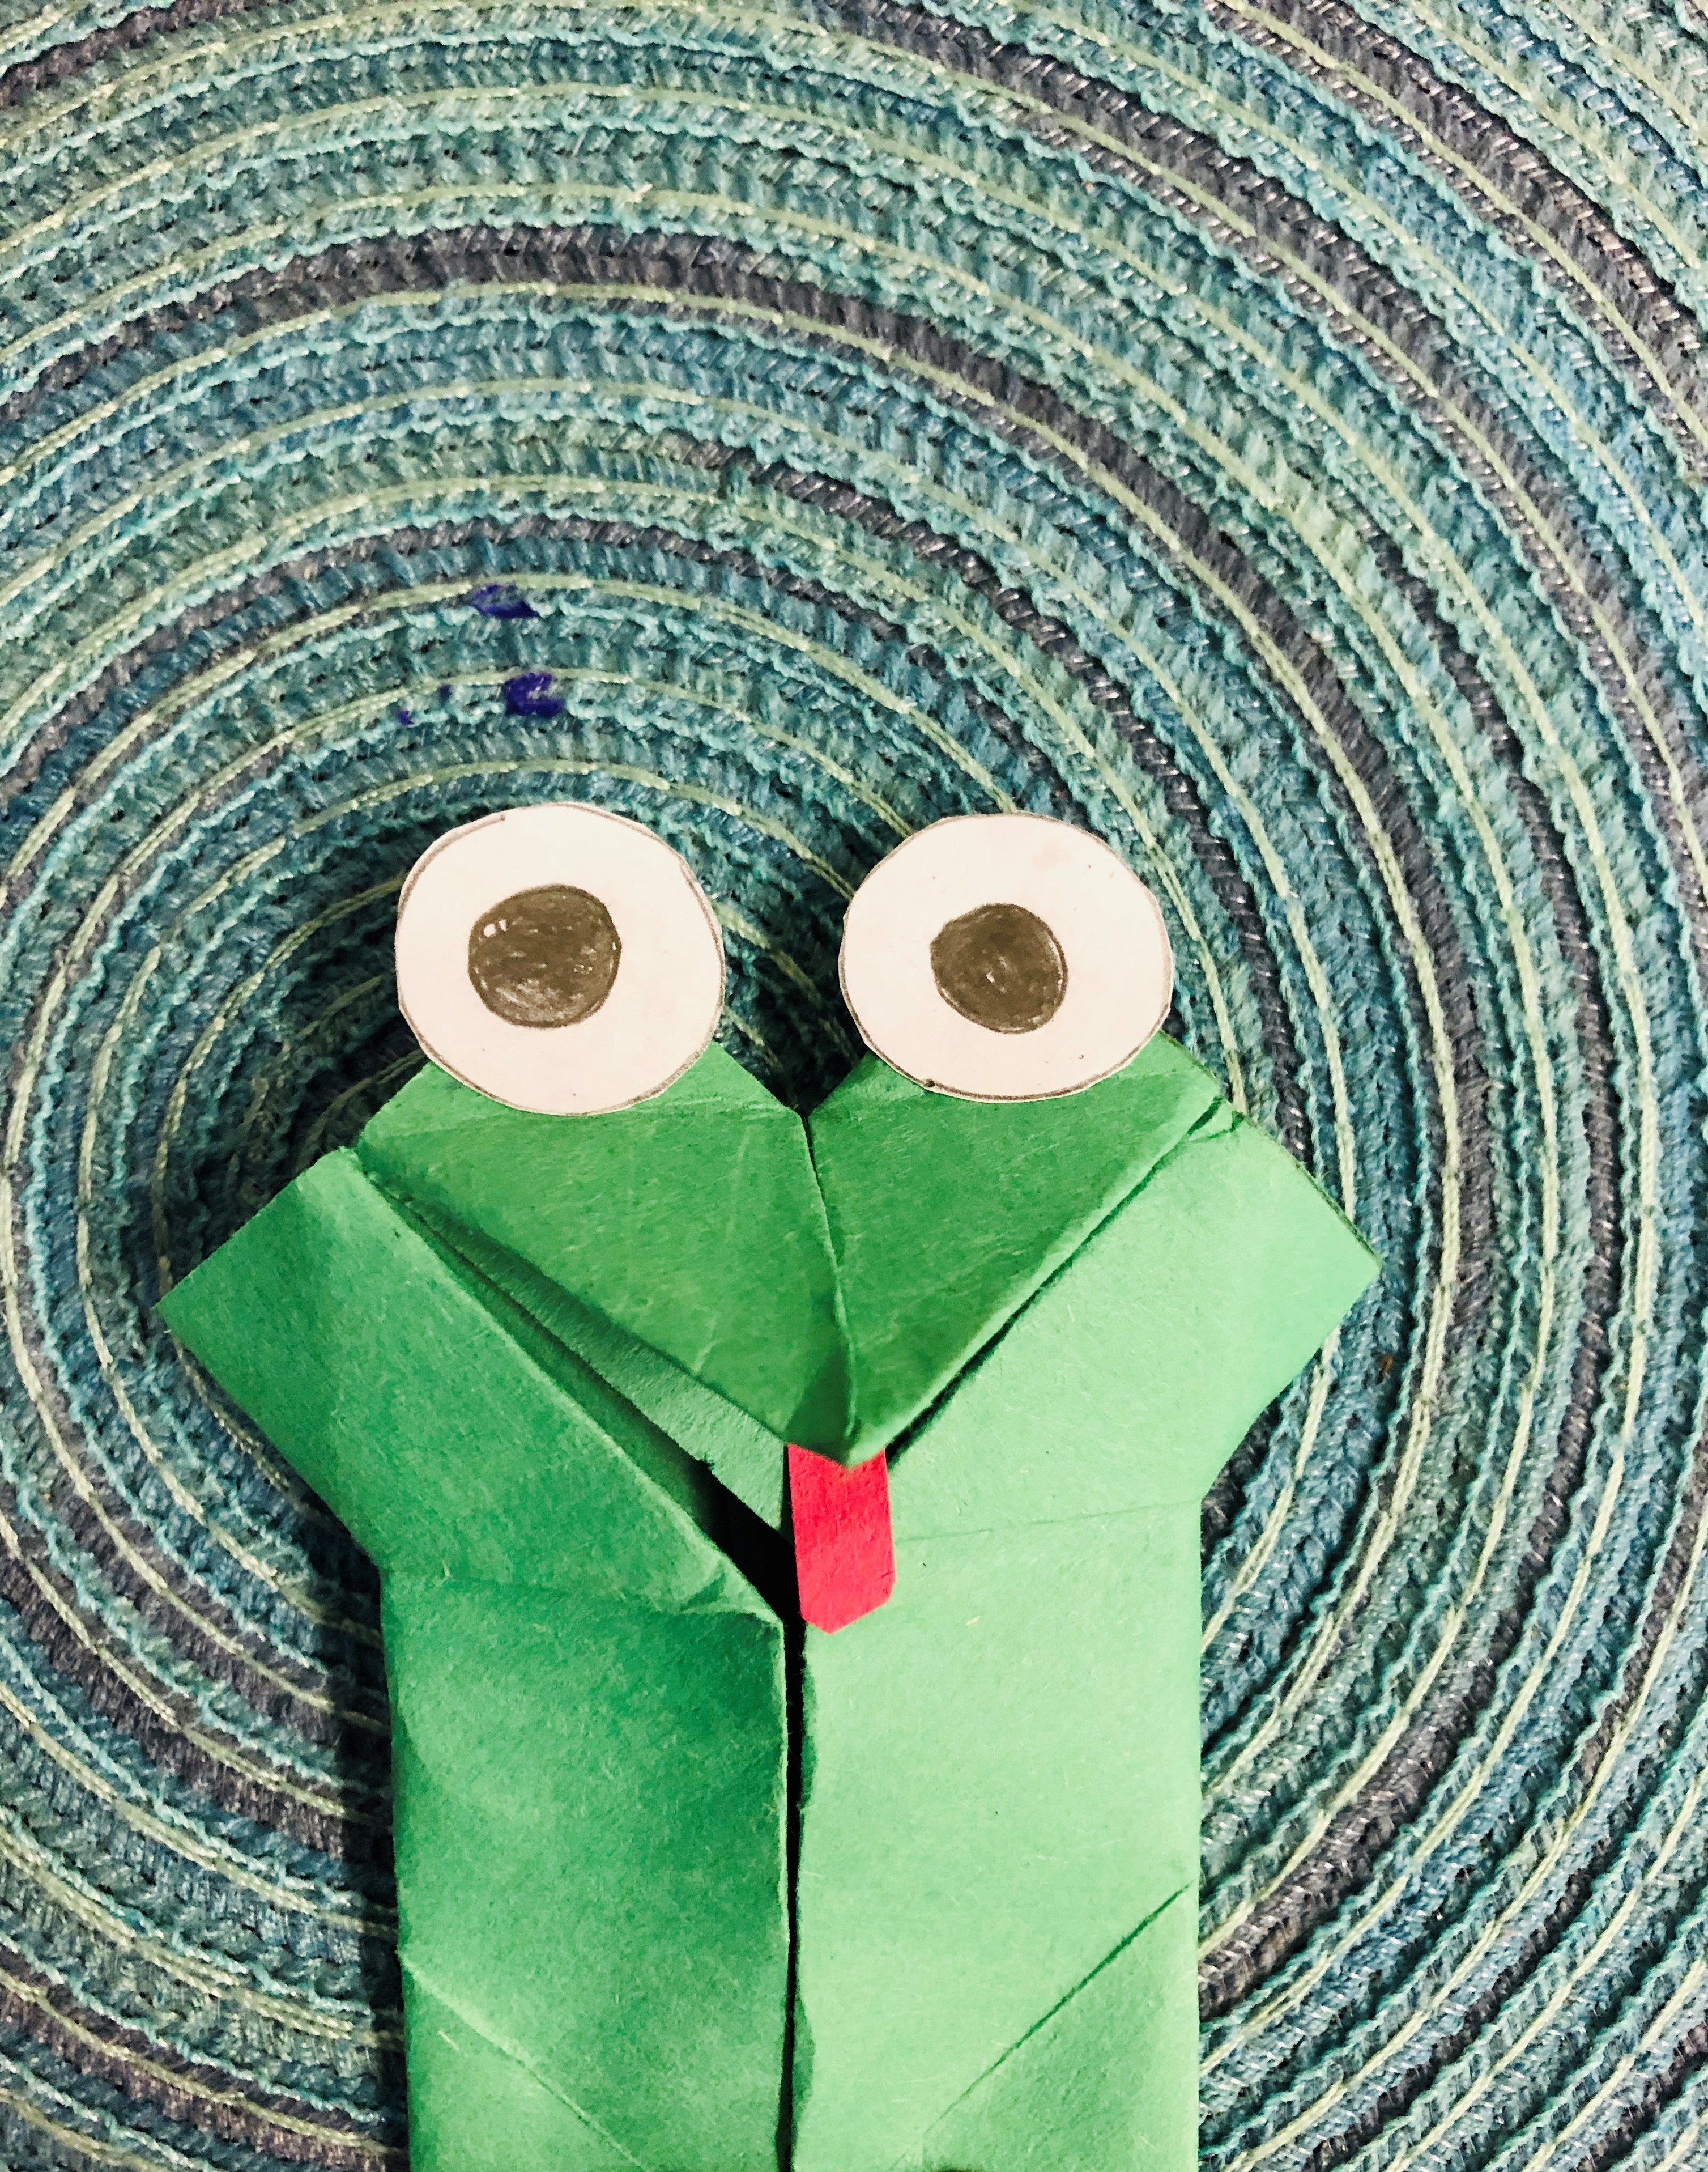
Lastly, glue/tape a tongue and eyes onto your frog.
When you pull on the paper tab the frogs mouth will open and close.

